Slide 1

BRACT’s Vishwakarma Institute of Information Technology Department of Engineering and Applied Sciences ET10203A: Basic Electrical Engineering A Project On “UPS System Of VIIT” Academic Year:2022-23 Semester:1 Batch: B2
Name | PRN | Roll No. | Contact Numbers
Pranav Morge | 22210467 | 228 | 9119435171
Pawan Chaudhari | 22210483 | 229 | 7666591553
Sanchit Chavan | 22210595 | 235 | 9527633816
Darshan Chougule | 22210611 | 236 | 9405862602
Siddhant Tade | 22210739 | 240 | 8459927380

Slide 2
CONTENTS
Introduction
Components:
Rectifier
Batteries
Inverter
Circuit Breakers
Working of UPS
Conclusions
References

Slide 3
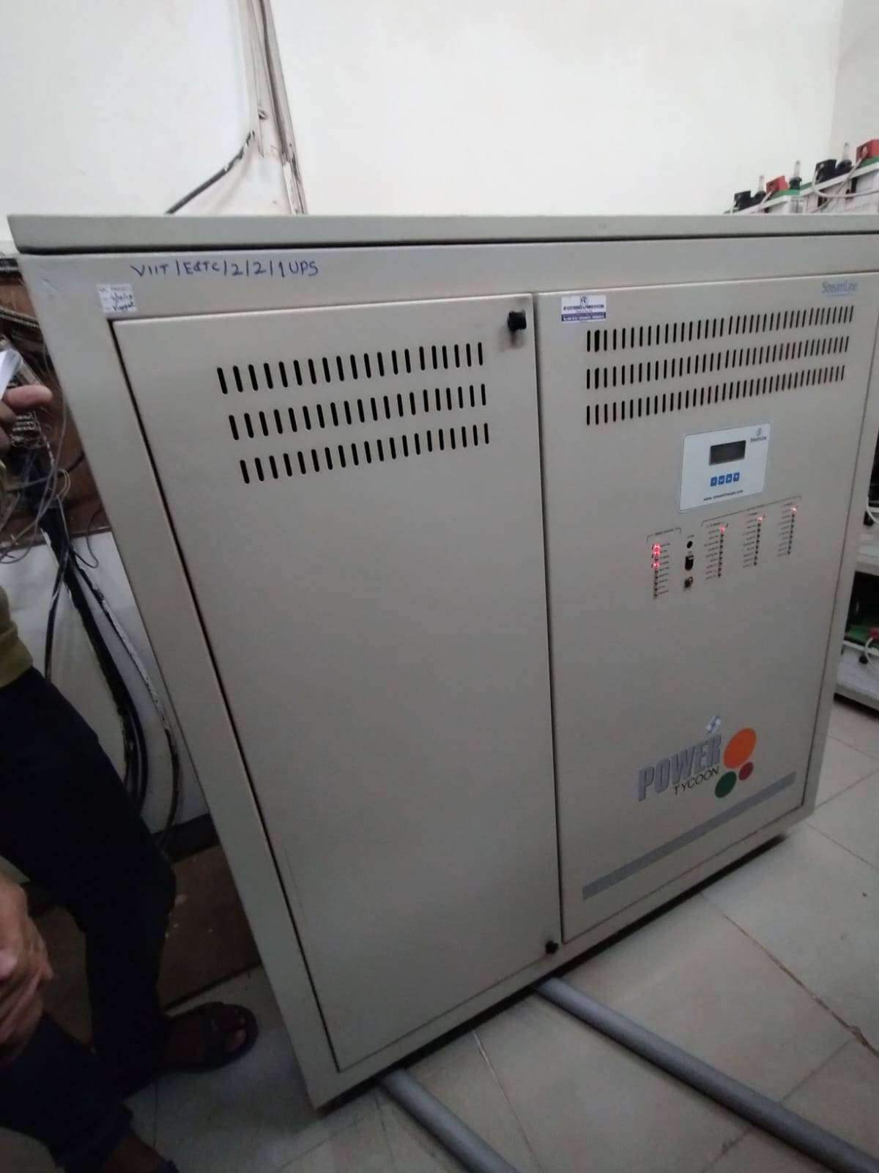
UPS: Uninterruptable Power System
There are several applications where even a temporary power failure can cause a great deal of public inconvenience leading to large economic losses. Examples of such applications are major computer installations, process control in chemical plant, safety monitors, general communication systems, hospital intensive care units (ICUs) etc. For such critical loads, it is of paramount importance to provide an uninterruptable power supply. Here, comes the importance of UPS. Application of UPS system caters to such critical loads.
VIIT campus spreads over 5-6 acres. There are many departments in this campus and they require uninterrupted power supply. There are many computer labs, workshop which depend on UPS for seem less power supply. For this purpose our college is equipped with UPS.
Darshan, Department of Engineering and Applied Sciences, VIIT, Pune-48

Slide 4
RECTIFIER
The rectifier is a component in an uninterruptible power supply (UPS) system that converts incoming AC power into DC power. The DC power is then stored in the battery, which serves as a backup power source during power outages or other disruptions to the main power source.
The rectifier typically consists of a series of diodes that convert the AC power into DC power by allowing current to flow in only one direction. The rectified DC power is then filtered to remove any remaining AC components, resulting in a clean and stable DC power source that can be stored in the battery.
The rectifier is a critical component in the UPS system, as it provides the DC power source that the inverter uses to generate the AC power that is supplied to the connected devices during a power outage. It is important to choose a rectifier that is suitable for the specific requirements of the UPS system, taking into account factors such as the expected load, the type of connected devices, and the environment in which the UPS will be used.
In summary, the rectifier plays a crucial role in the UPS system, by converting incoming AC power into a stable DC power source that can be used to supply power to connected devices during power outages and other disruptions.
Pawan, Department of Engineering and Applied Sciences, VIIT, Pune-48

Slide 5
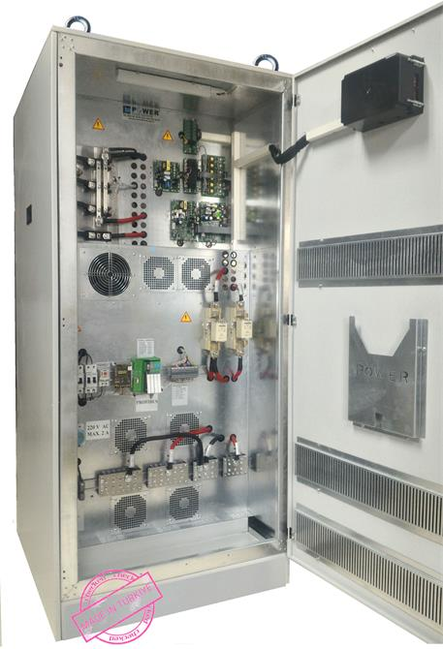
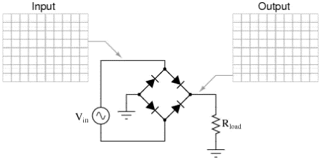
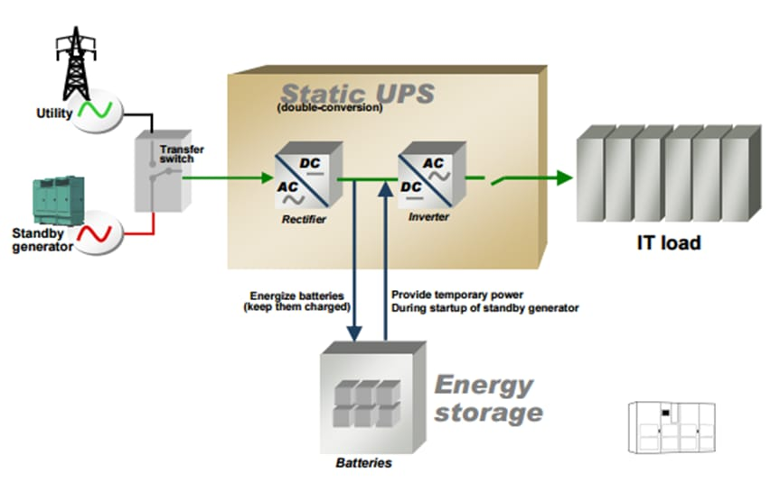
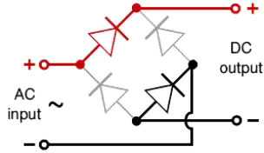
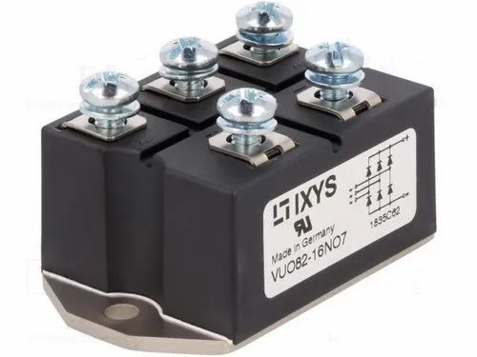
Pawan, Department of Engineering and Applied Sciences, VIIT, Pune-48

Slide 6
BATTERIES
The battery is a crucial component in an uninterruptible power supply (UPS) system. Its main function is to store energy and provide backup power to connected devices during power outages or other disruptions to the main power source.
UPS batteries can be of various types, including lead-acid batteries, nickel-cadmium (NiCad) batteries, and lithium-ion (Li-ion) batteries. The type of battery used in a UPS system depends on the specific requirements of the system, such as the expected run time, the desired level of reliability, and the desired level of maintenance. Lead-acid batteries are the most commonly used type of battery in UPS systems, due to their low cost and high capacity, while Li-ion batteries offer longer run times and lower maintenance requirements, but are more expensive.
The battery in a UPS system is charged by the rectifier, which converts incoming AC power into DC power and stores it in the battery. When a power outage occurs, the battery provides the DC power source that the inverter uses to generate AC power that can be used by connected devices.
Sanchit, Department of Engineering and Applied Sciences, VIIT, Pune-48

Slide 7
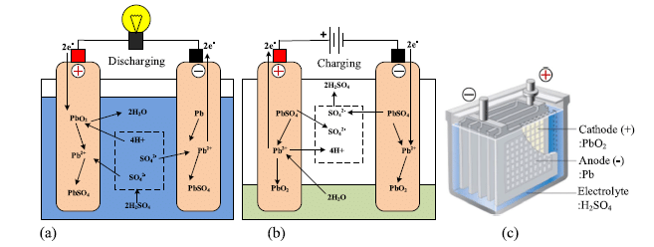
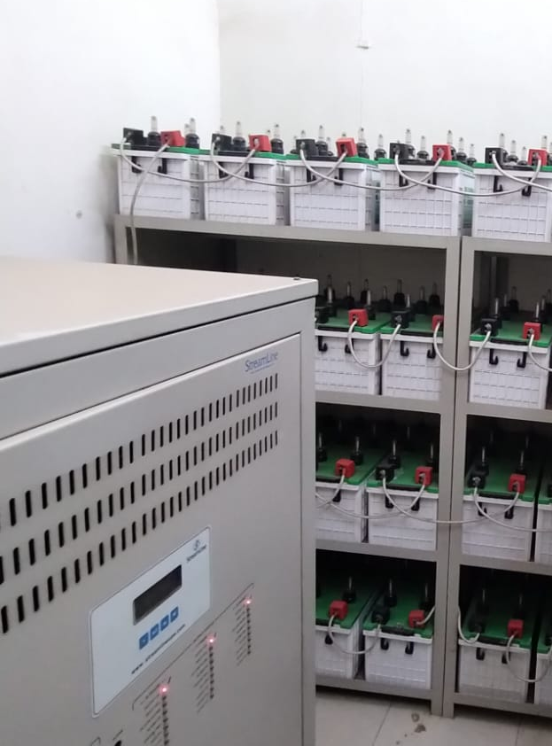
The battery in a UPS system is typically designed to provide power for a limited amount of time, typically in the range of a few minutes to several hours, depending on the specific requirements of the system. To ensure that the battery is always in good condition, the charge controller in the UPS regulates the charging and discharging of the battery.
In UPS structure of VIIT we use 30 lead-acid batteries with a voltage rating of 12 volts each for supply of each building. All these batteries are connected in series and thus sum up to a total voltage of 360 volts. This backup is then used to provide power when there is a power outage for around 20-30 mins till the manual generator starts to supply power.
Sanchit, Department of Engineering and Applied Sciences, VIIT, Pune-48

Slide 8
INVERTER
The inverter is a key component in an uninterruptible power supply (UPS) system. Its main function is to convert the DC power stored in the UPS battery into AC power that can be used by connected devices.
When the main power source, such as the electrical grid, is functioning normally, the rectifier in the UPS converts the incoming AC power into DC power, which is then stored in the battery. When a power outage occurs, the inverter takes over, drawing power from the battery and converting it back into AC power. This provides a continuous supply of AC power to the connected devices, allowing them to continue functioning even if the main power source is lost.
Inverters in UPS systems can be of various types, including square wave, modified sine wave, and pure sine wave inverters. The type of inverter used depends on the specific requirements of the UPS system, such as the type of connected devices, their power requirements, and the desired level of power quality. Pure sine wave inverters are typically more expensive but provide a cleaner and more stable output, while square wave and modified sine wave inverters are less expensive and simpler in design but provide a lower quality output.
Overall, the inverter plays a critical role in the UPS system, ensuring that connected devices have a reliable source of power during power outages and other disruptions.
Pranav, Department of Engineering and Applied Sciences, VIIT, Pune-48

Slide 9
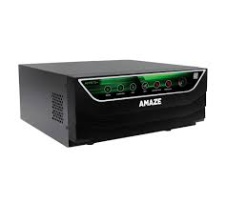
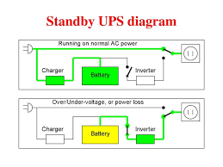
Pranav, Department of Engineering and Applied Sciences, VIIT, Pune-48

Slide 10
Circuit Breakers
Circuit breakers in uninterruptible power supplies (UPS) are electrical safety devices that are designed to protect the UPS and connected devices from damage due to power surges or short circuits. They work by automatically interrupting the flow of electricity when a hazardous condition is detected, such as an overcurrent, voltage spike, or ground fault. This helps prevent damage to the UPS components, connected devices, and the electrical wiring.
Circuit breakers in UPS systems come in various types and ratings, depending on the specific requirements of the system. Some of the most common types include thermal-magnetic circuit breakers, which respond to both current and temperature, and electronic circuit breakers, which use solid-state components to detect and interrupt overcurrents.
Siddhant, Department of Engineering and Applied Sciences, VIIT, Pune-48

Slide 11
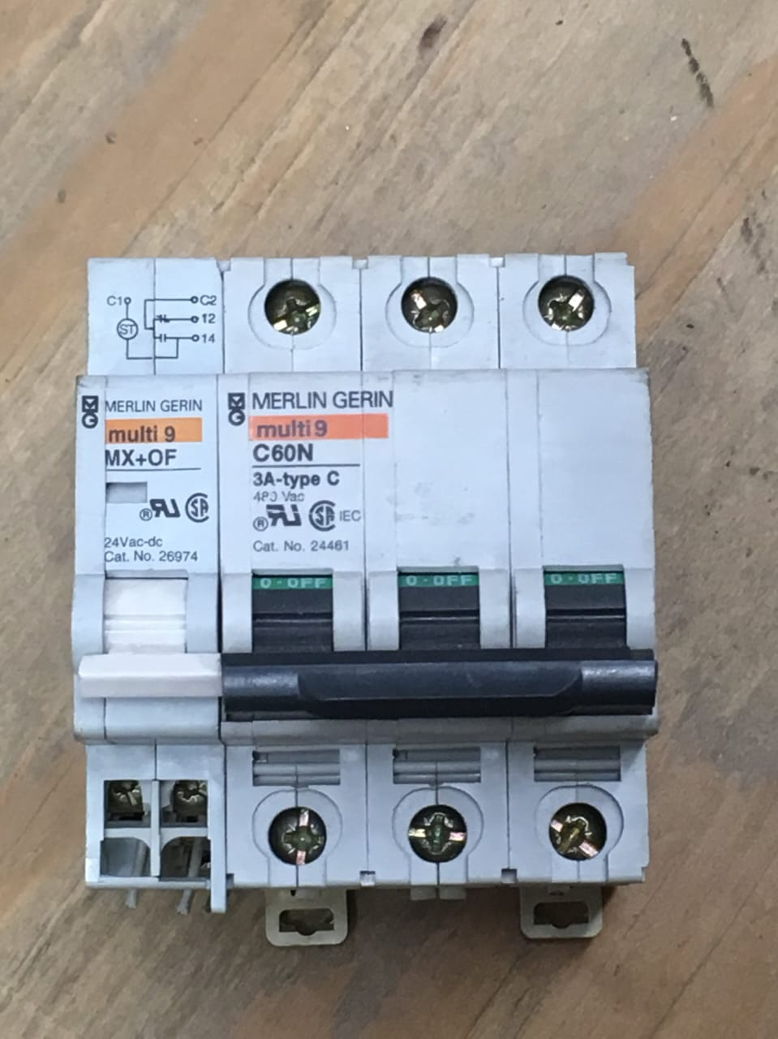
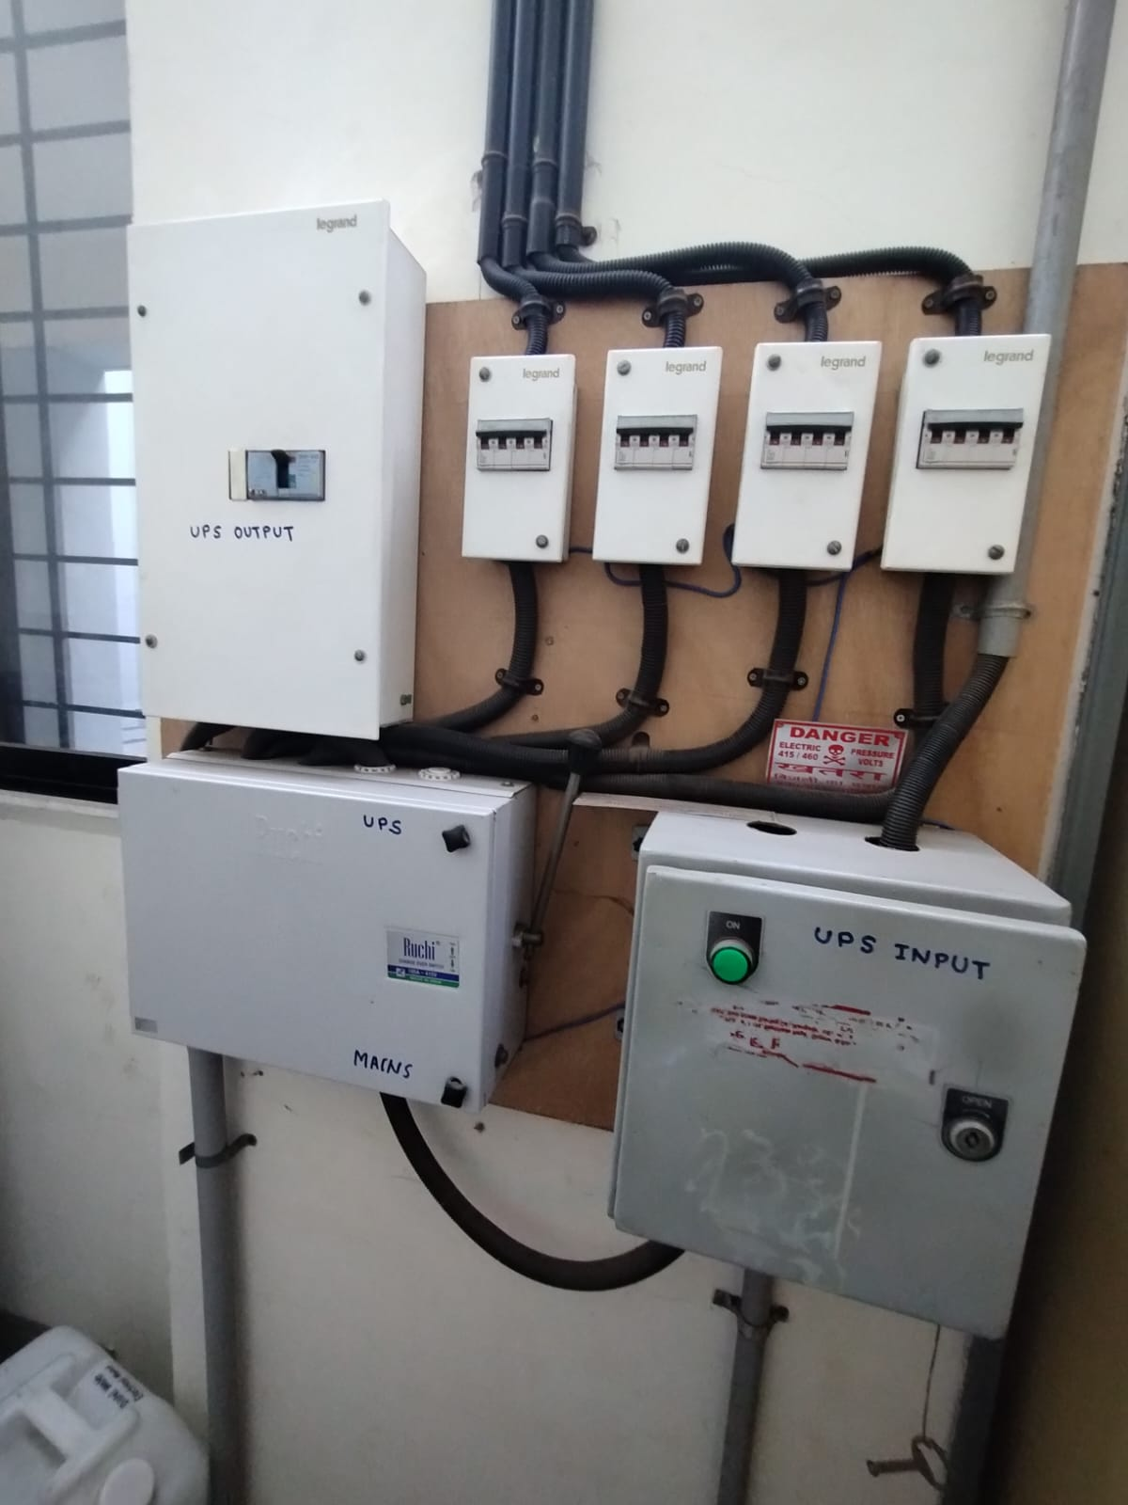
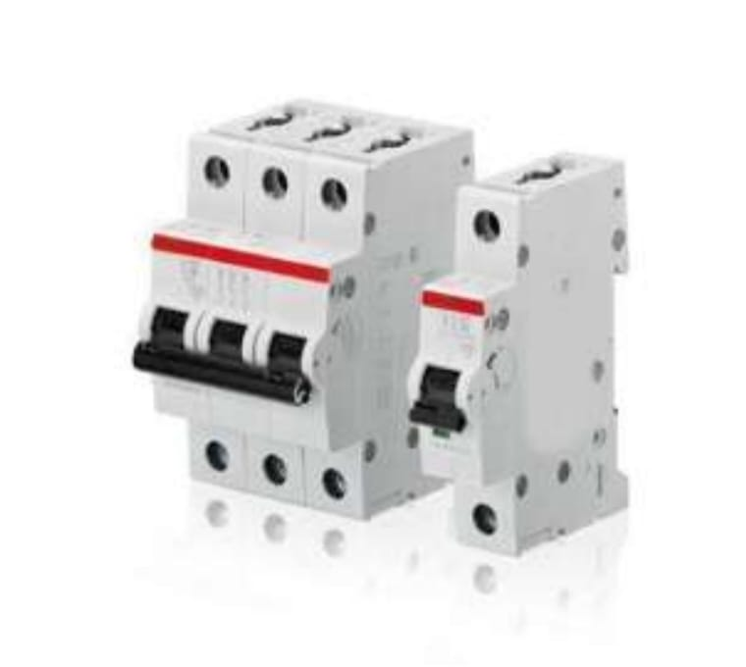
The selection of the appropriate type and rating of circuit breaker is critical to the safe and reliable operation of the UPS system. It is important to consider factors such as the expected load, the type of connected devices, and the environment in which the UPS will be used, when choosing a circuit breaker for a UPS system.
Siddhant, Department of Engineering and Applied Sciences, VIIT, Pune-48

Slide 12
Working Of UPS
Incoming AC power: The UPS receives incoming AC power from the electrical grid.
Rectification: The rectifier in the UPS converts the incoming AC power into DC power, which is then stored in the battery.
Battery charging: The charge controller in the UPS regulates the charging and discharging of the battery to ensure that it is always in good condition.
Power conditioning: When a power outage or other disruption occurs, the battery provides the DC power source that the inverter uses to generate AC power.
Inversion: The inverter converts the DC power from the battery into AC power, which is then supplied to the connected devices.
Circuit protection: Circuit breakers in the UPS protect the UPS and connected devices from damage due to power surges or short circuits.
Power management: The UPS system monitors the incoming power and switches between the main power source and the backup power source as needed, to ensure that connected devices have a continuous and reliable source of power.
Darshan, Department of Engineering and Applied Sciences, VIIT, Pune-48

Slide 13
Darshan, Department of Engineering and Applied Sciences, VIIT, Pune-48

Slide 14
REFERENCES
How Lead Acid Battery Works: https://youtu.be/HhxtfULIO7c
https://en.wikipedia.org/wiki/Lead%E2%80%93acid_battery
“Basic Electrical Engineering” book By V. K. Mehta
(Page 492: 10.2-> Lead Acid Cell)
Department of Engineering and Applied Sciences, VIIT, Pune-48

Slide 15
Thank You!

